Slide 1

2021 Maine Potato Conference via Zoom
Screening potato clones for pink rot resistance
Sylvia Zhang, PhD student
Advisor: Jay Hao
The University of Maine
Notes:
field and storage disease

Slide 2
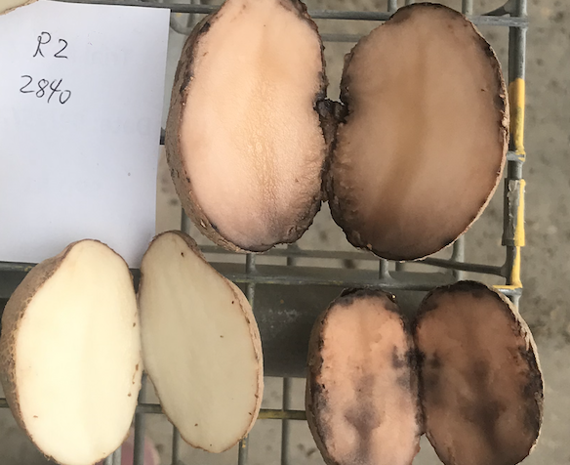
Pink rot (Phytophthora erythroseptica) is a major threat in Maine
Healthy
Diseased
Notes:
Pink rot is an essential storage disease of potatoes, caused by a soil-borne pathogen Phytophthora erythroseptica (P. erythroseptica)
Tuber symptoms are more obvious, which is characteristic as pink rot. Tuber decay starts from the stolon. In the early stages of infection, infected tissue becomes rubbery. When infected tubers are cut, a dark line is delimiting the rotted portion from the healthy tissue and cut tuber will turn to pink color after 20 minutes expose to air, which is the typical symptom of pink rot(Fitzpatrick-Peabody and Lambert, 2011b).
In most instances, the infected tuber will become soft. After cutting the rotted tuber, the tissues are creamy and the smell from tuber is odorous. Because the rotted tubers are easily infected by many bacteria, such as Pectobacterium spp. (Stevenson, 2001).

Slide 3

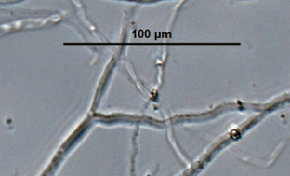

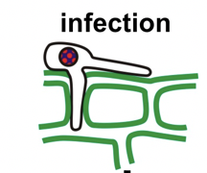

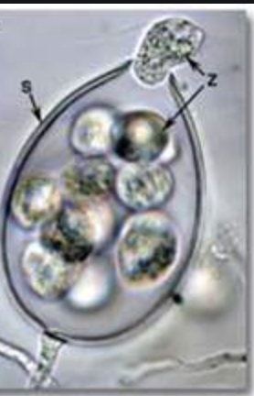
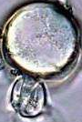

Life cycle of Phytophthora erythroseptica
Sexual reproduction
Asexual reproduction
Mycelia
Oogonium & antheridium
Sporangium
Oospores
Zoospores
Notes:
Phytophthora erythroseptica could produces sexual spores called oospores, and sporangia in asexual reproduction(Erwin and Ribeiro, 1996b; Kroon et al., 2012). At the end of season, in the edges of infected lesions of plant, oospores are produced with thick cell wall that help them to survive in winter. Oospores can live in soil around ten years (Vujičić and Park, 1964). Until the soil temperature near 77 °F, oospores develop rapidly and infect potato stems, stolon and tubers. If the environment is optimal, oospores of P. erythroseptica will produce an asexual stage consisting of sporangia and mycelia. Sporangia is consisting of zoospores, usually the older sporangia could germinate directly by forming a germ tube but younger produce a lot of zoospores(Chapman and Vujicic, 1965).

Slide 4
Why screening for resistant varieties?
Chemicals are not fully effective in controlling the soilborne pathogen
Concerns about fungicide resistance
  P. erythroseptica has >75% population resistant to Ridomil in Maine
Concerns about environmental impact in a long term
Cost
Enhance potato yield and quality

Slide 5
Host resistance for pink rot control
Susceptible | Moderate resistant | Highly tolerant
Red LaSoda | Ranger Russet | Snowden
Shepody | Russet Burbank | Atlantic
Goldrush |  | Pike
Russet Norkotah

Slide 6
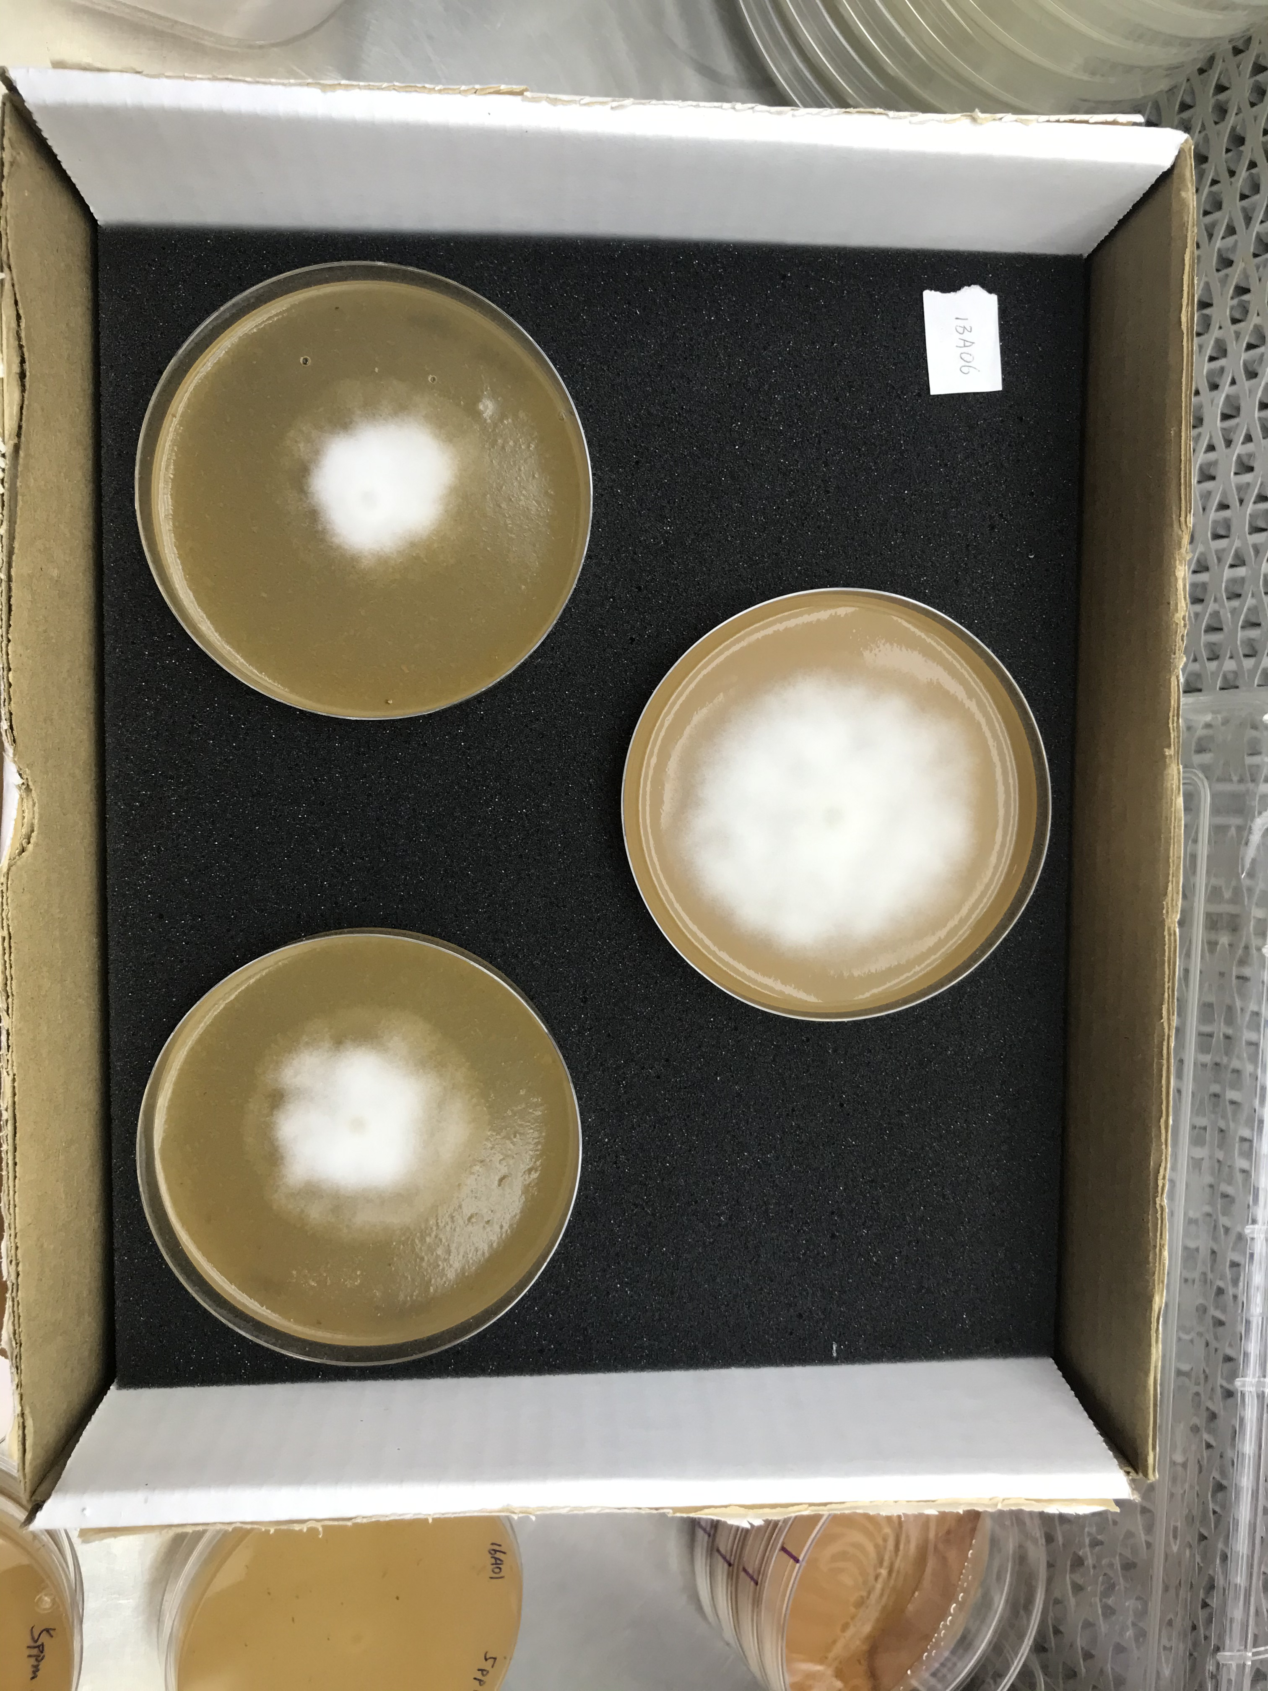
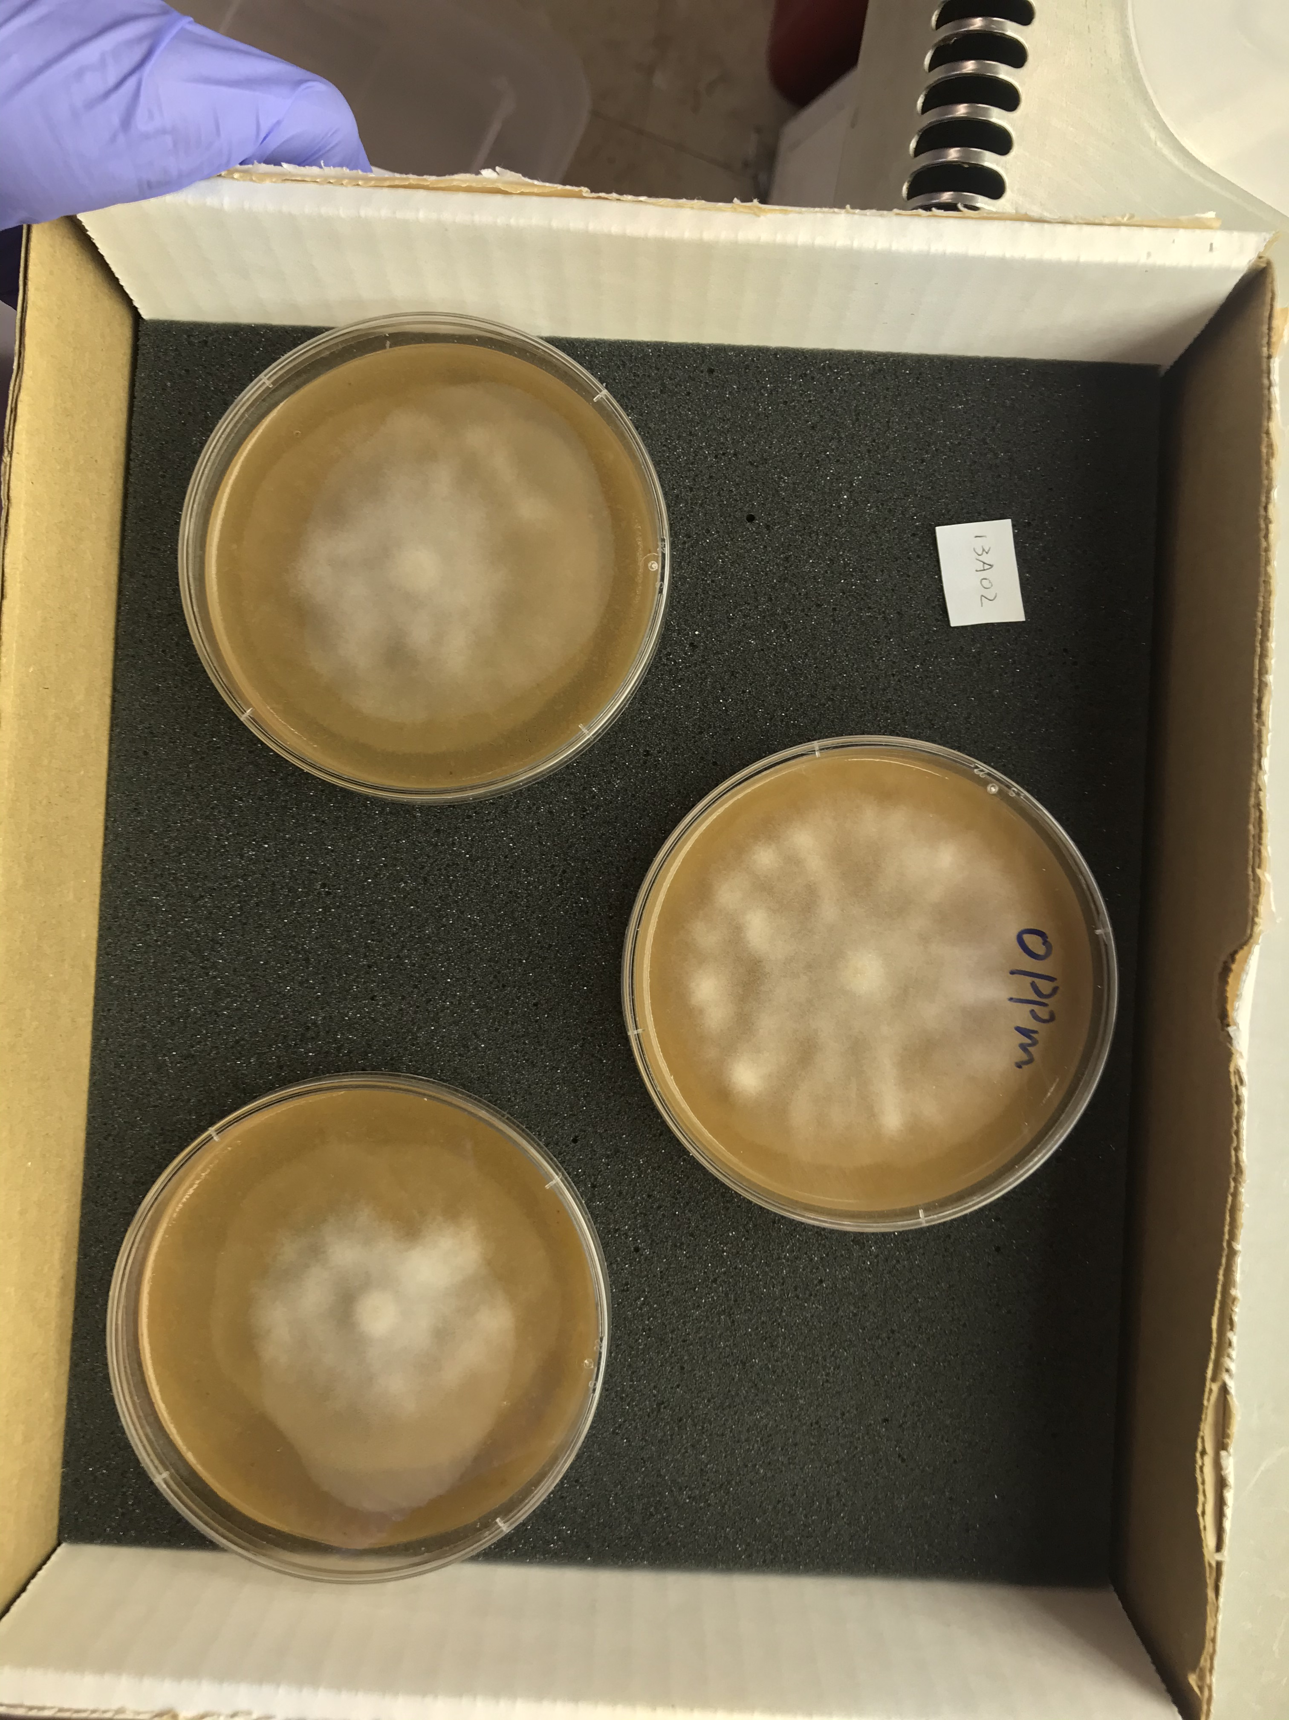
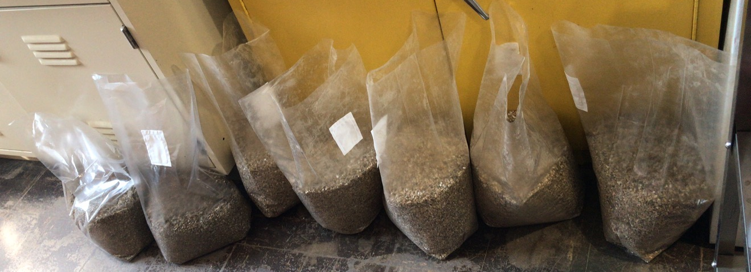
Field inoculation
Inoculum
  5 P. erythroseptica isolates
  Incubated 4 weeks at room temperature
Inoculation
  1.5 L inoculum applied to each 10-ft row
  Hand planting at 1-ft spacing
Evaluation
  2 weeks post harvest
  Disease
  Yield

Slide 7
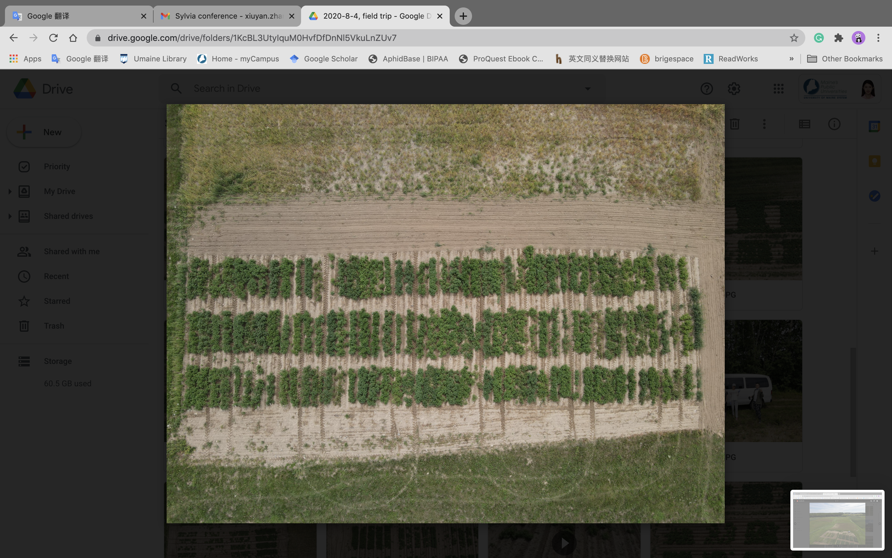

Slide 8
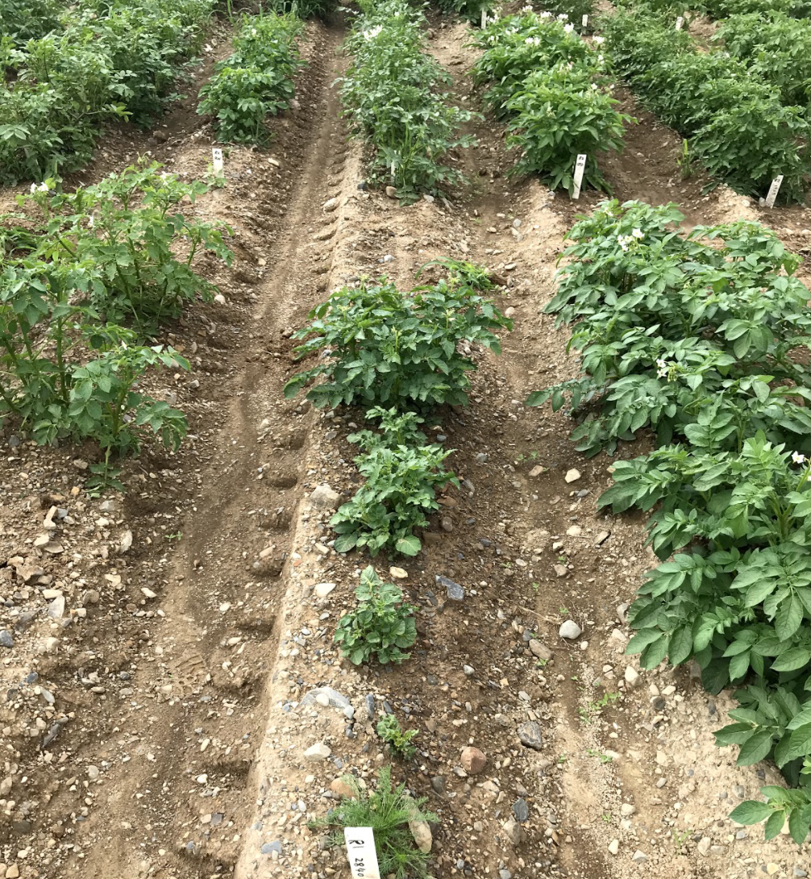
susceptible
resistant

Slide 9
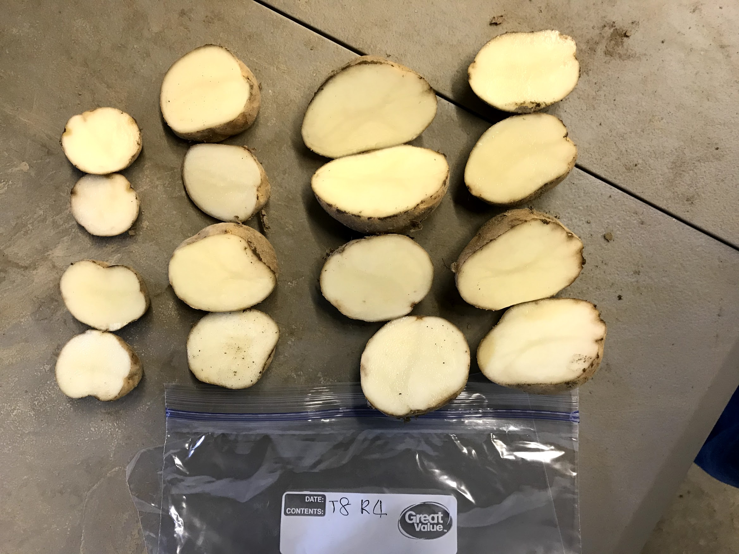
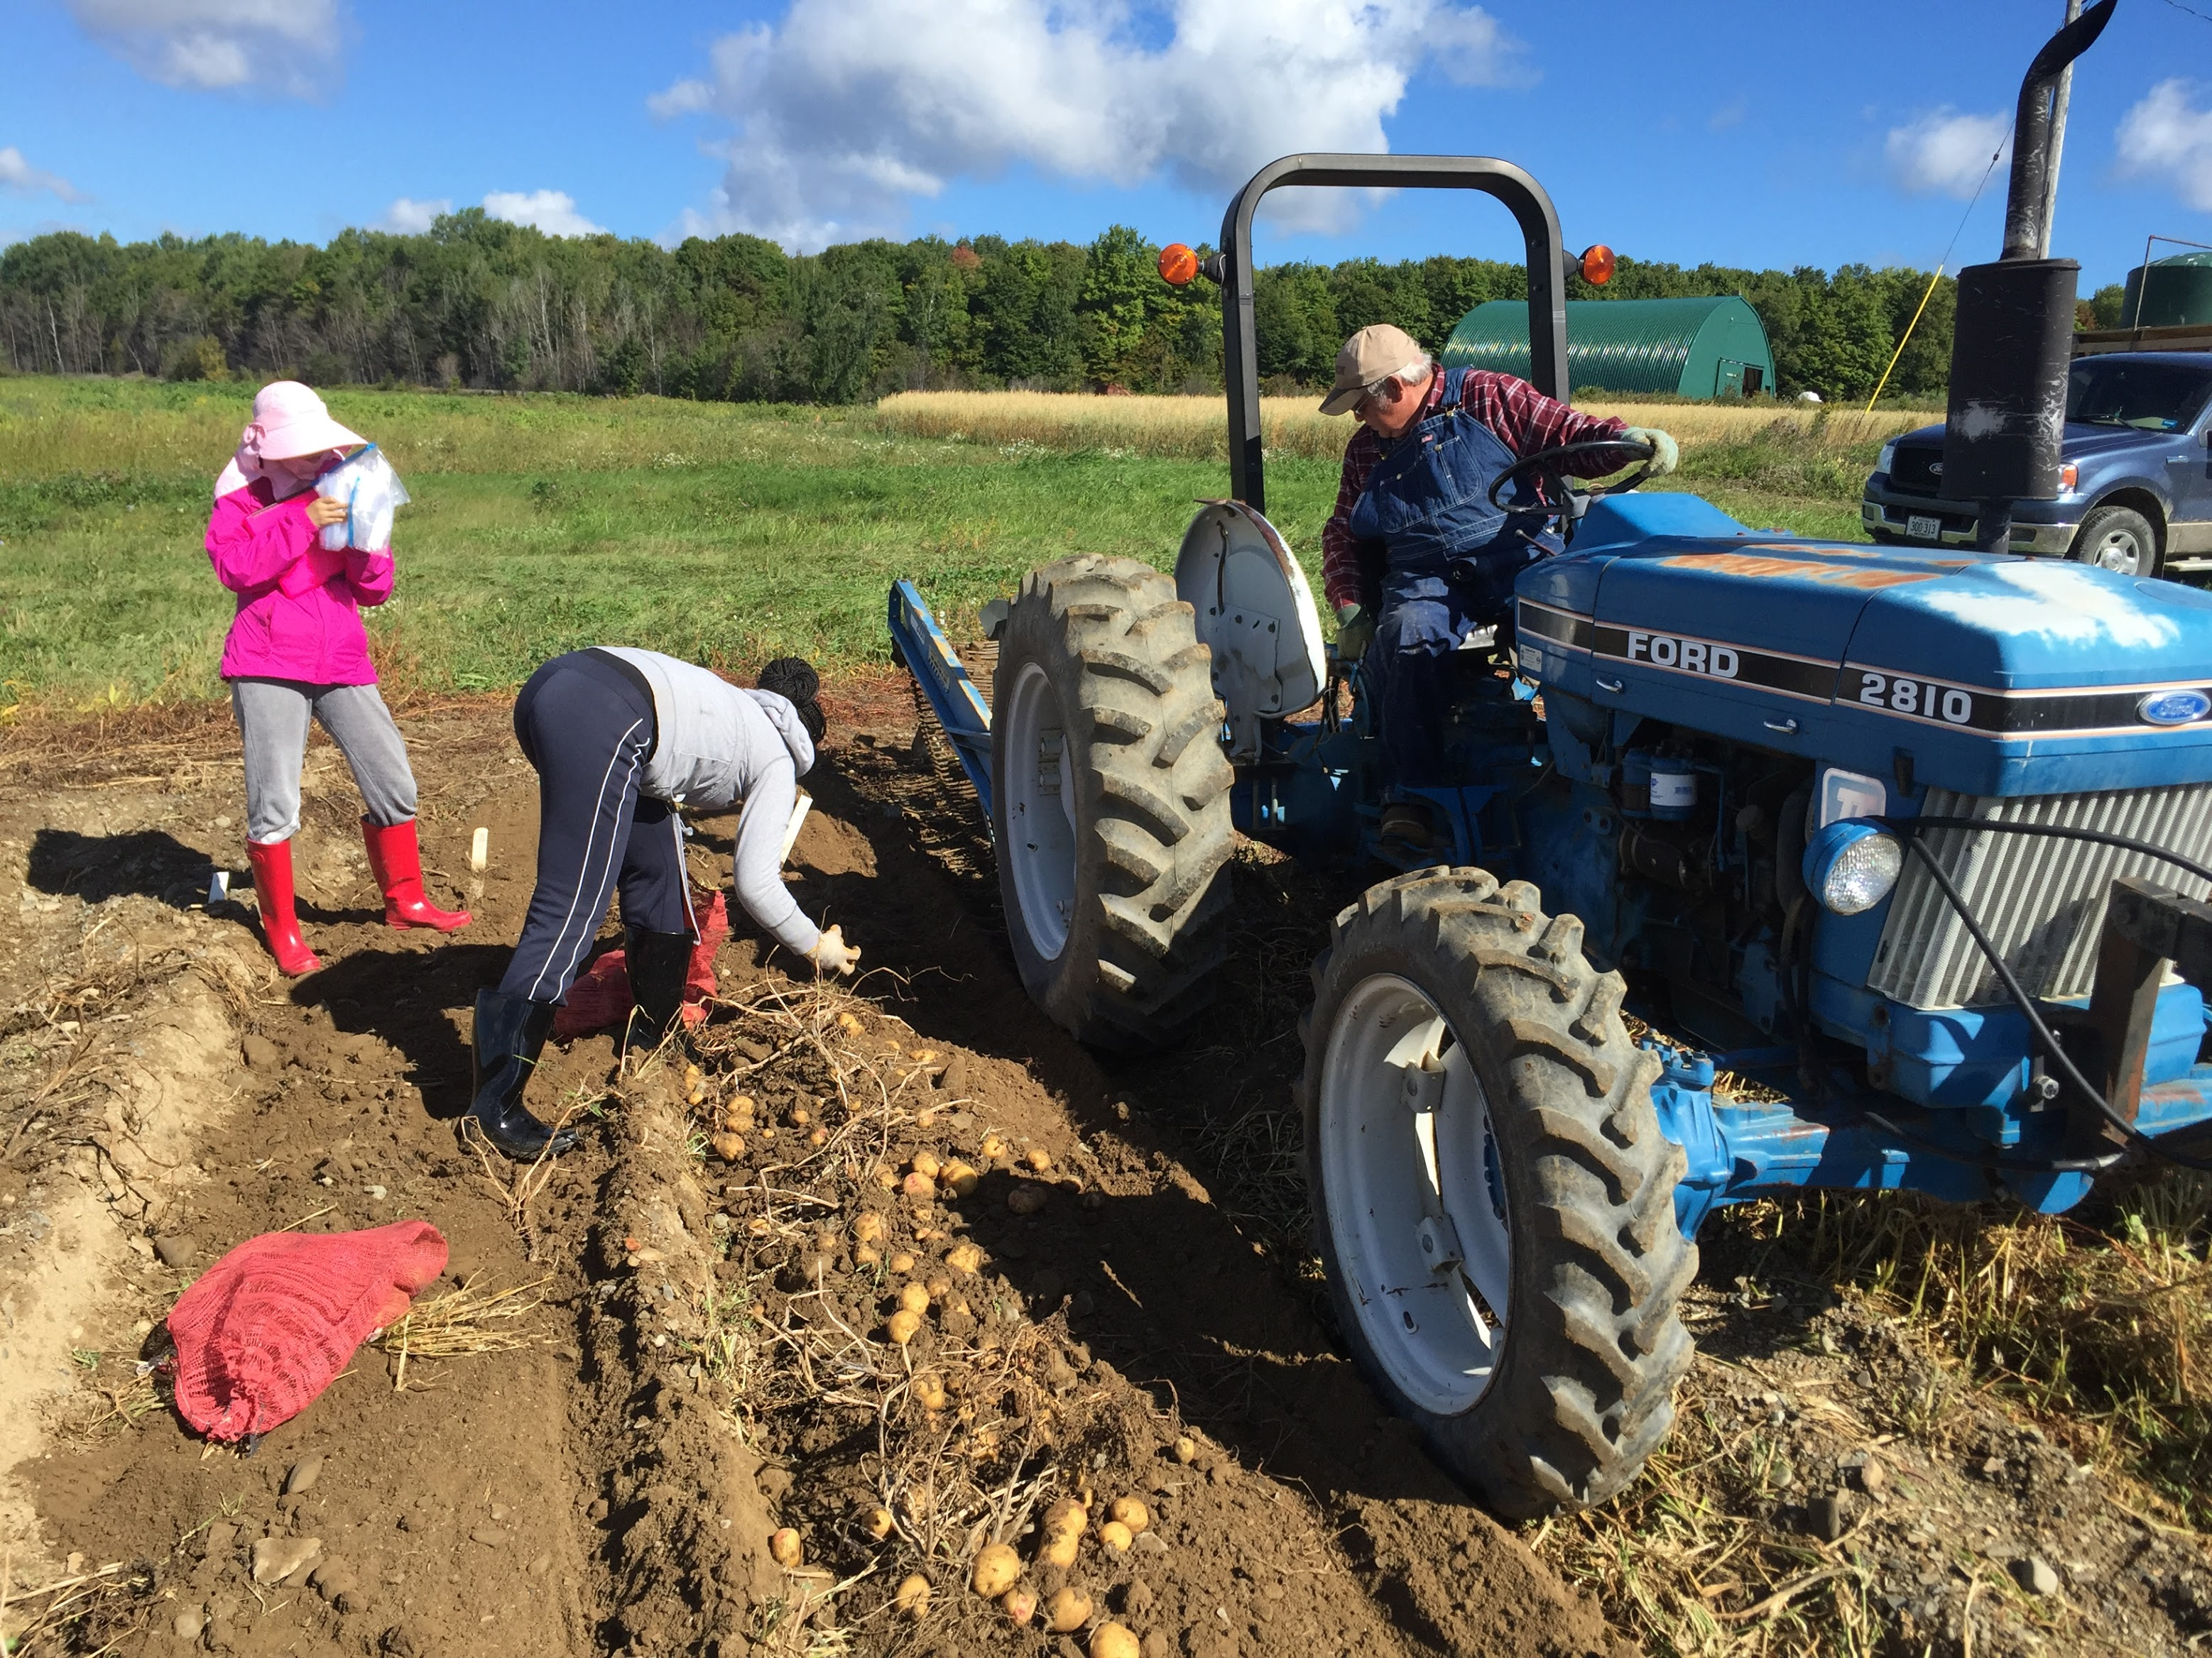

Slide 11
2019
Dark Red Norland

Slide 12
2020
Disease incidence (%)
Yield (number of tubers/plant)
Potato Germplasm / Variety

Slide 13
Multi-year evaluation of selected clones
 | AF4831-2 | AF4648-2 | AF5245-1 | AF5406-7 | AF3317-15 | AF5280-5 | WAF10073 | AF5179-4
2017 | M | R | R | R | R | M | R | S
2018 | R | R | M | M | - | R | M | S
2019 | M | R | R | R | - | R | R | M
2020 | - | R | R | S | R | S | M | -
CLONES
YEAR
S: Susceptible M: Moderate R: Resistance

Slide 14
Top pick of pink-rot-resistant potato germplasms
CLONES |  | Commercial Variety
AF5735-8 | MSAFB609-12 | Yukon Gem
AF5406-7 | AF4831-2 | Atlantic
AF3317-15 | AAF10943-4 | Dark Red Norland
MSAFB635-15 | AF5741-6 | Snowden
MSAFB605-4 | AAF10596-1 | Pike
AF4648-2 | AF5245-1 | Lamoka
Notes:
showed low disease incidence and high yield across the four years study

Slide 15
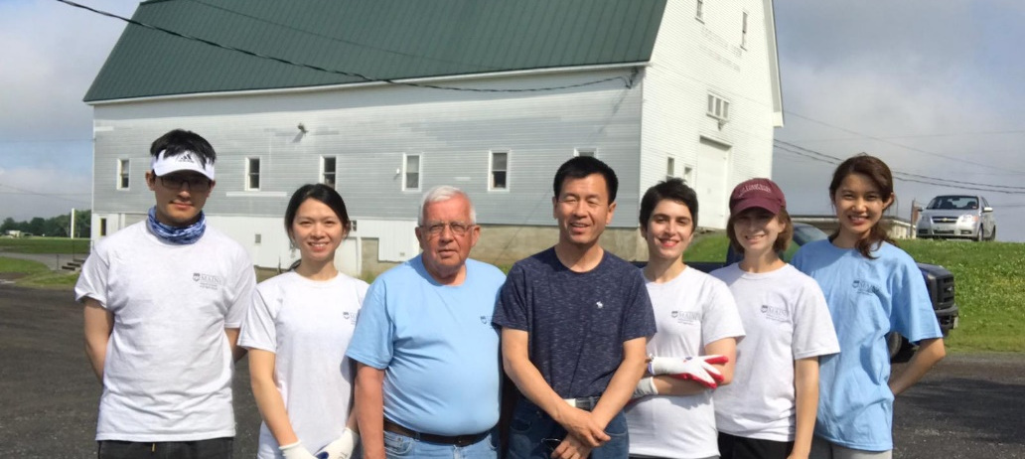

Acknowledgments
Dr. Jay Hao
Dr. Gregory Porter
Dr. Steven Johnson
Elbridge Giggie
Lab members
  Dr. Helen Jiang, Tongling Ge
  Andrea Hain, Cody Li, Fatemeh Ekbataniamiri, Adwoa Dankwa
Funding
  Maine Potato Board
  USDA-NIFA
Notes:
who contribute what
Thanks for them

Slide 16
Thanks!

